Slide 1

Automation Testing
By- Manas

Slide 2
WEBELEMENT
Sometimes we are working on the same element repeatedly for multiple times. In that case instead of identifying the same element again and again for multiple times, we are creating the reference for that element by using WebElement. So that here after we can start working on the element with the help of reference.
Syntax:
WebElement Reference = driver.findElement(by. locator(“Value”));

Slide 3
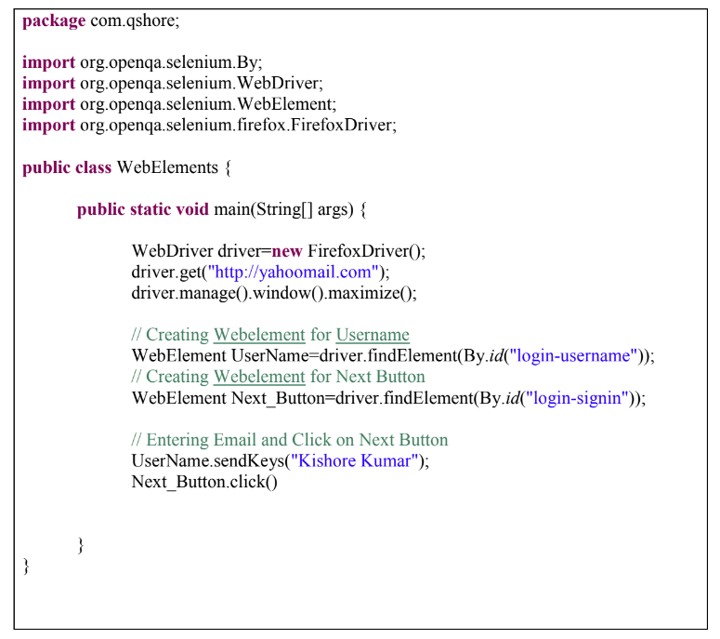
Example: Prepare test Script to Enter Username and Click on Next Button in http://yahoomail.com by creating WebElement.

Slide 4
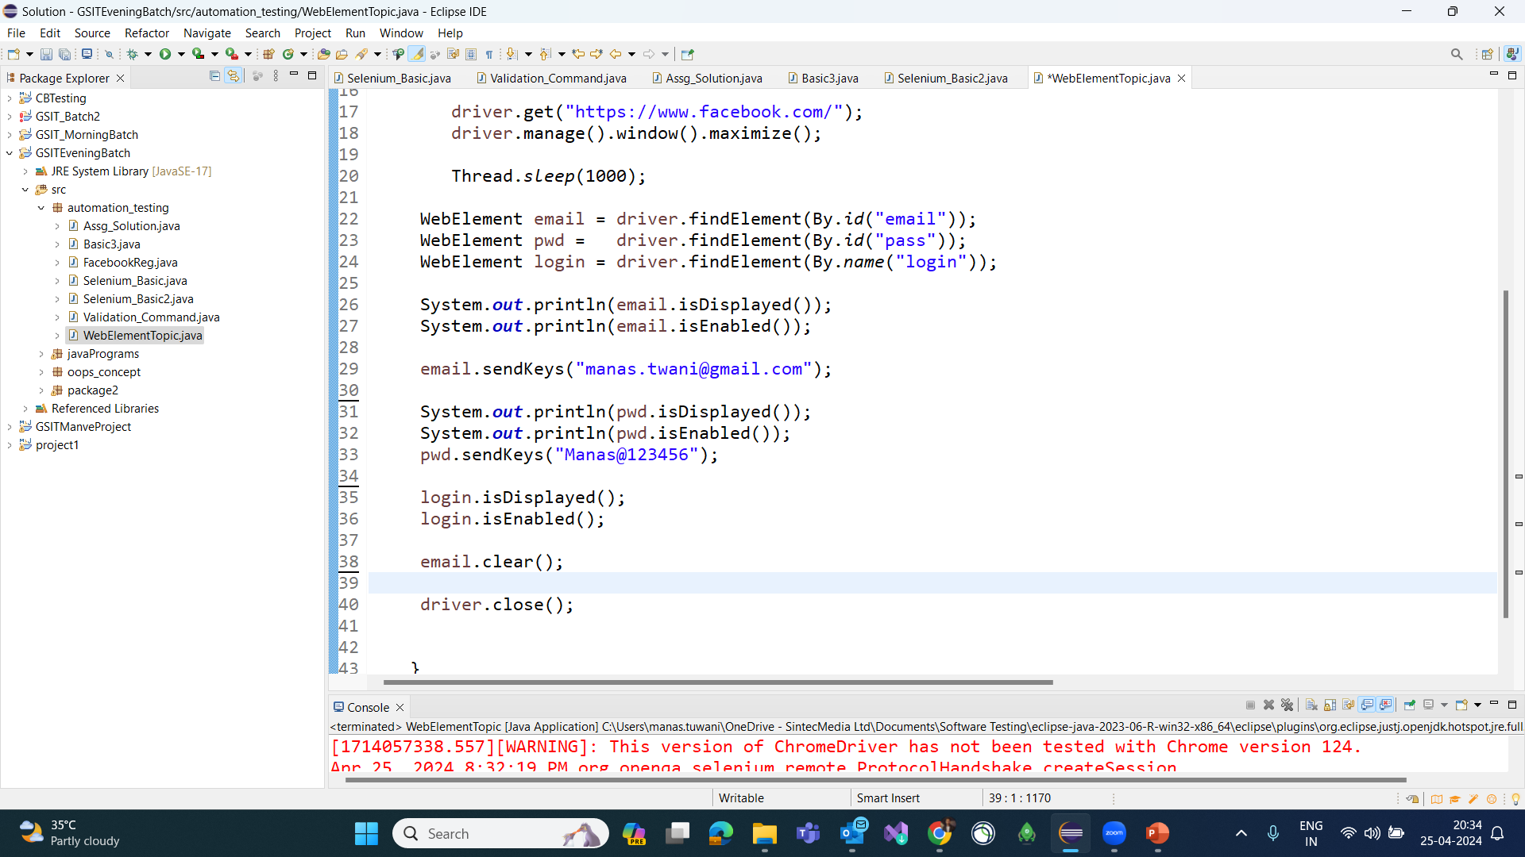

Slide 5
